Slide 1
Practice Exam
MATH 1550 - Precalculus

Slide 2
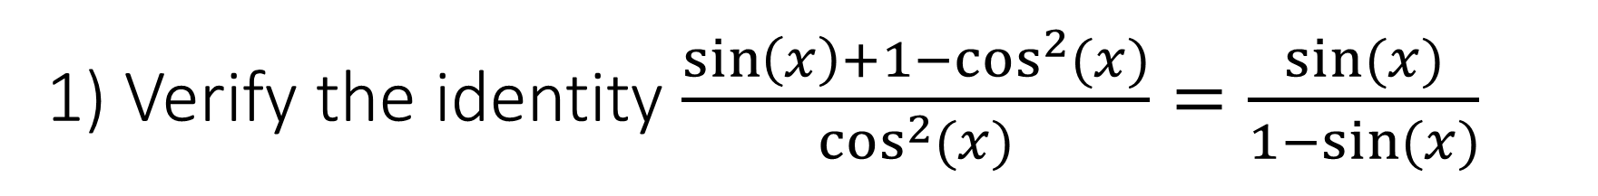
1) Verify the identity $\frac{\sin\left(x\right)+1−\cos^{2}{(x)}}{\cos^{2}{(x)}}=\frac{sin⁡(x)}{1−sin⁡(x)}$

Slide 3
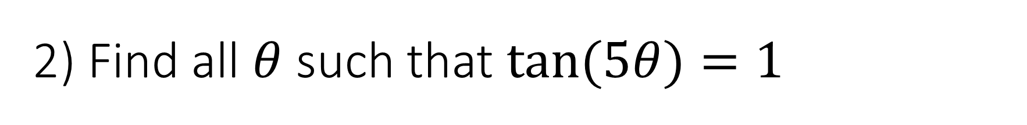
2) Find all $θ$ such that $\tan{(5θ)}=1$

Slide 4
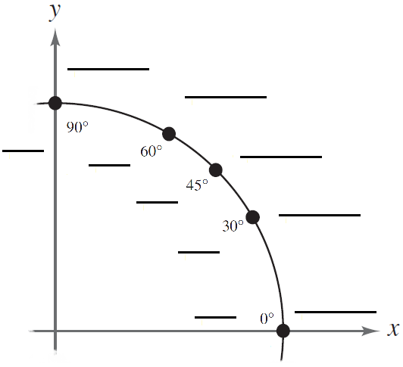










3) Complete the unit circle:
$$\left(0,1\right)$$
$$\left(\frac{1}{2},\frac{\sqrt{3}}{2}\right)$$
$$\left(\frac{\sqrt{2}}{2},\frac{\sqrt{2}}{2}\right)$$
$$π/2$$
$$π/3$$
$$\left(\frac{\sqrt{3}}{2},\frac{1}{2}\right)$$
$$π/4$$
$$π/6$$
$$0$$
$$\left(1,0\right)$$

Slide 5
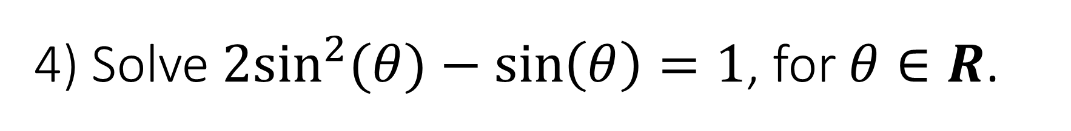
4) Solve $2\sin^{2}{(θ)}−\sin\left(θ\right)=1$, for $θ∈R$.

Slide 6










5) Evaluate:
$sin⁡({135}^{∘})$
$\tan\left(−\frac{5π}{3}\right)$
$$2$$
$$−\frac{5π}{3}$$
$$\sqrt{3}$$
$$\sqrt{2}$$
$$1$$
$$\frac{π}{3}$$
135⁰
$$1$$
45⁰
$$−1$$

Slide 7





5) Evaluate:
$csc⁡({420}^{∘})$
$\tan\left(−\frac{5π}{3}\right)$
$$2$$
$$−\frac{5π}{3}$$
$$\sqrt{3}$$
$$2$$
$$\frac{π}{3}$$
$$\sqrt{3}$$
$$1$$
$${60}^{∘}$$
$$1$$

Slide 8

5) Evaluate:
$csc⁡({420}^{∘})$
$\cot\left(18π\right)$
$$2$$
$$\sqrt{3}$$
$${60}^{∘}$$
$$1$$

Slide 9





5) Evaluate:
$\sec\left[\arcsin\left(\frac{\sqrt{2}}{5}\right)\right]$
$\cot\left(18π\right)$
$$5$$
$$\sqrt{2}$$
$$θ$$
$$\sqrt{23}$$

Slide 10





5) Evaluate:
$\sec\left[\arcsin\left(\frac{\sqrt{2}}{5}\right)\right]$
$\arctan\left(−\frac{\sqrt{3}}{3}\right)$
$$\sqrt{3}$$
$$θ$$
$$5$$
$$\sqrt{2}$$
$$−1$$
$$2$$
$$θ$$
$$\sqrt{23}$$

Slide 11






5) Evaluate:
$\cos\left(\frac{11π}{12}\right)$
$\arctan\left(−\frac{\sqrt{3}}{3}\right)$
$$\sqrt{3}$$
$$\sqrt{3}$$
$$θ$$
$$\frac{π}{6}$$
$$\frac{11π}{6}$$
$$−1$$
$$−1$$
$$2$$
$$2$$

Slide 12


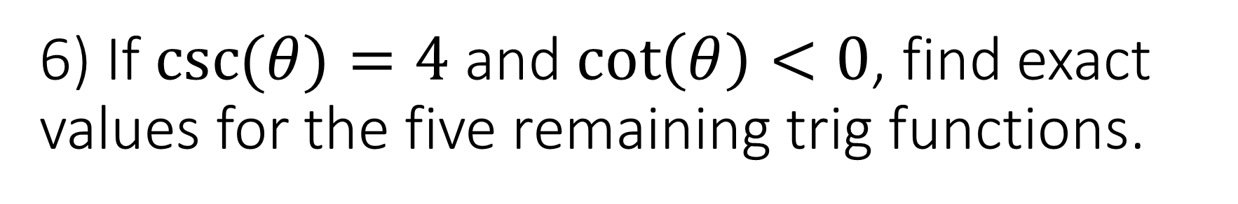



6) If $\csc{(θ)}=4$ and $\cot\left(θ\right)<0$, find exact values for the five remaining trig functions.
$$4$$
$$1$$
$$α$$
$$θ$$
$$−\sqrt{15}$$

Slide 13
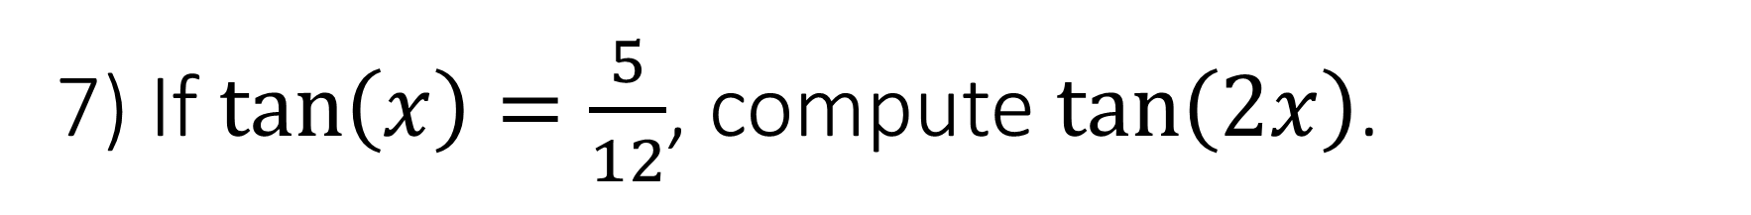
7) If $\tan\left(x\right)=\frac{5}{12}$, compute $\tan\left(2x\right)$.

